Slide 1

Dependency Injection in ASP.NET Core
Rajsing S. Jadhav

Slide 2
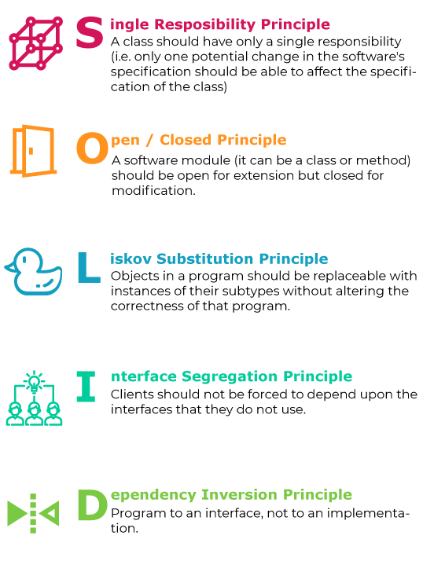
What is Dependency Injection?
Dependency Injection (DI) is a design pattern that allows a class to receive its dependencies rather than creating them itself. This pattern is one of the key concepts used to achieve Inversion of Control (IoC).
Inversion of Control (IoC): This refers to a shift in the control of flow from the application to an external entity (in this case, the dependency injection container). Instead of a class creating its dependencies, they are provided externally.
Key Principles:
Decoupling: DI decouples components and services from each other. A class doesn't need to know how to create its dependencies, reducing tight coupling. This makes the code easier to modify, test, and maintain.
Separation of Concerns (SoC): DI promotes the separation of responsibilities, which leads to cleaner and more organized code. The class focuses on its primary responsibility, while its dependencies are provided from external sources.

Slide 3

Types of DI
1. Constructor Injection (Most Common in ASP.NET Core)
Dependencies are provided through the class constructor when it’s instantiated.
Use Case: Common in controllers to receive services like business logic, data access, and logging.
2. Property Injection (Less Common but Useful)
Dependencies are injected through public properties after the class is created.
Use Case: Suitable for optional dependencies or when dealing with configuration.
3. Method Injection (Less Common)
Dependencies are passed directly into a method rather than the class.
Use Case: Useful when only specific methods need the dependency, often for short-lived operations

Slide 4
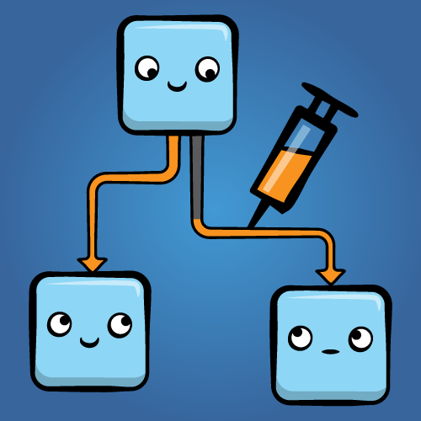
Service Lifetimes in ASP.NET Core DI
1. Transient Services
A Transient service is created each time it is requested from the DI container.
Use Transient for lightweight, stateless services that do not need to persist data across requests or sessions
2. Scoped Services
A Scoped service is created once per request (or scope). It is used to maintain state during the processing of a single HTTP request, and the same instance is used for all components within that request.
This is ideal for services such as data access, business logic components, and unit of work patterns.
3. Singleton Services
A Singleton service is created once and shared throughout the application's entire lifetime. This instance is created when it is first requested, and subsequent requests will use the same instance for the lifetime of the application.

Slide 5
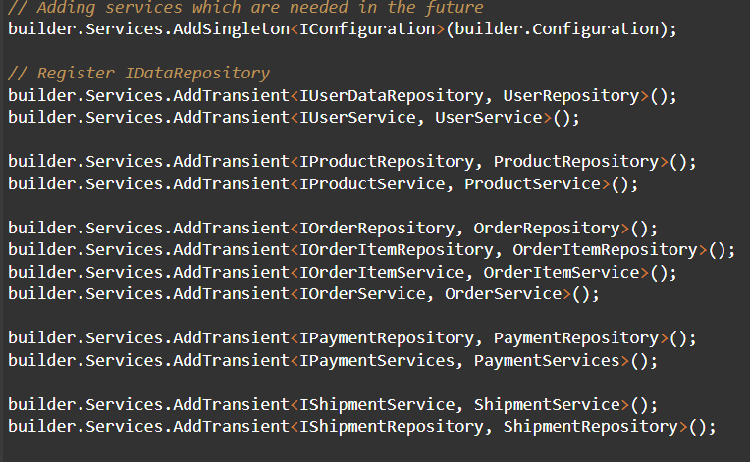
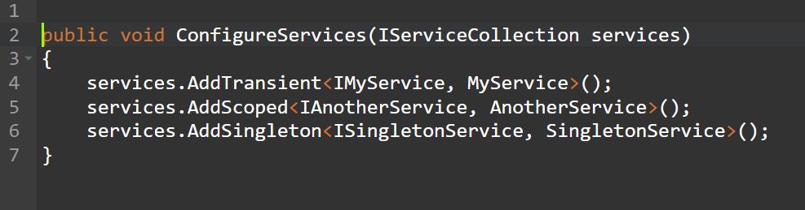
Registering and Configuring Services in ASP.NET Core
Registering Dependencies in ConfigureServices:
Services are added to the DI container in the ConfigureServices method of Program.cs

Slide 6
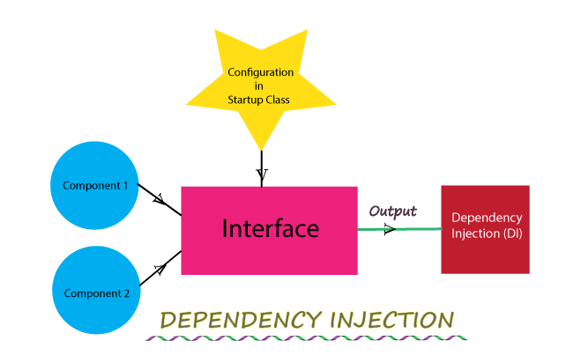
Benefits and Conclusion
Benefits of Dependency Injection:
Decoupling: Components are less dependent on each other.
Testability: Easier to test components with mock dependencies
.
Maintainability: Easier to modify and maintain code.
Flexibility: Swap implementations without affecting consumers
.
Conclusion:
DI is a core concept in ASP.NET Core that facilitates better application design.
It enhances scalability, maintainability, and testing of web applications.
Understanding and using DI effectively is crucial for building modern, modular web applications.
.

Slide 7




THANK YOU
(844) 720-6678
info@simplifyhealthcare.com
simplifyhealthcare.com
Simplify Healthcare
U.S.: 600 N Commons Drive, Suite 110, Aurora, IL 60504
India: 401/402, 4th Floor, Pentagon P-2, Magarpatta City, Pune 411013
CONNECT WITH US
LinkedIn
YouTube
X
Instagram

